Slide 1
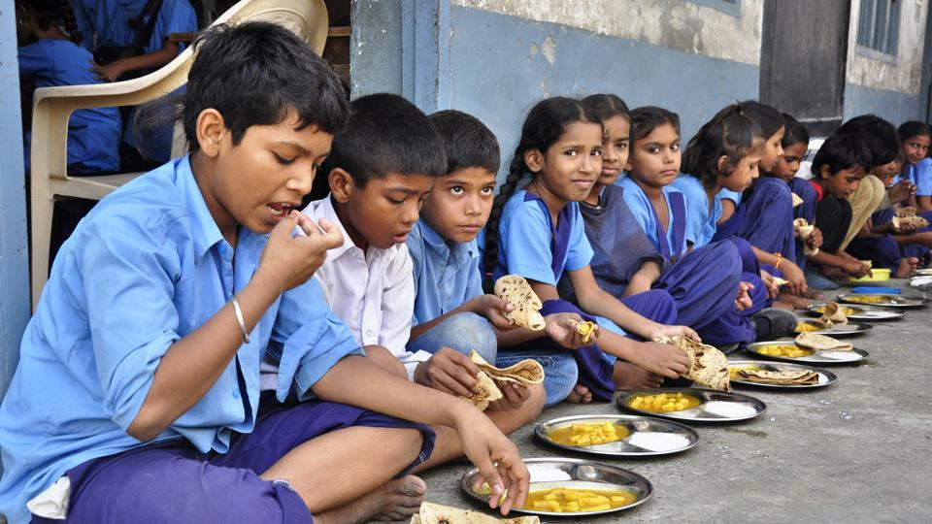

MID DAY
MEAL WEB
Presented by:
3150 Jaydeep khot
3142 Pratik More
3053 Rajesh More

Slide 2
Agenda
management of mid day meal at ZP level
efficient supply chain
reducing food wastages
keeping quantity track
Our Key Discussion Points

Slide 3
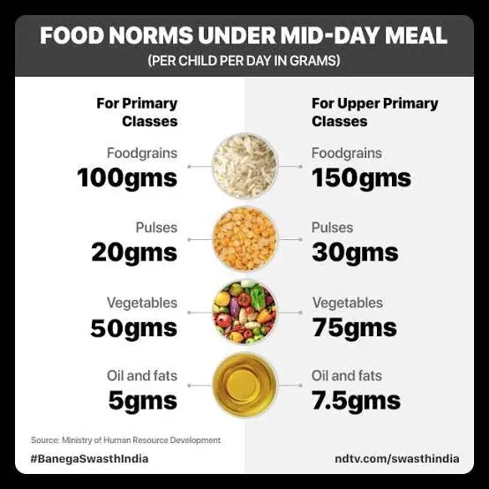
Quantity Calculation
government provides guidelines regarding quantity.
each school has its own rice index according to that other ingredient's must be added into the meal. this will help to overall growth of students and have a control on uses of material.

Slide 4
prior count of student and plates upload on portal
01
the admin can track the data at backend
02
Food Wastage
Control
school will get information regarding quantity of ingredients
03
according to number of plates they should cook meal
04
this process will help to reduce wastage of food
05

Slide 5
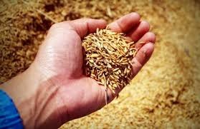

Quantity Management
the portal has track of grains used per day this will help to ensure in time delivery . And also stop malpractices in this schme

Slide 6
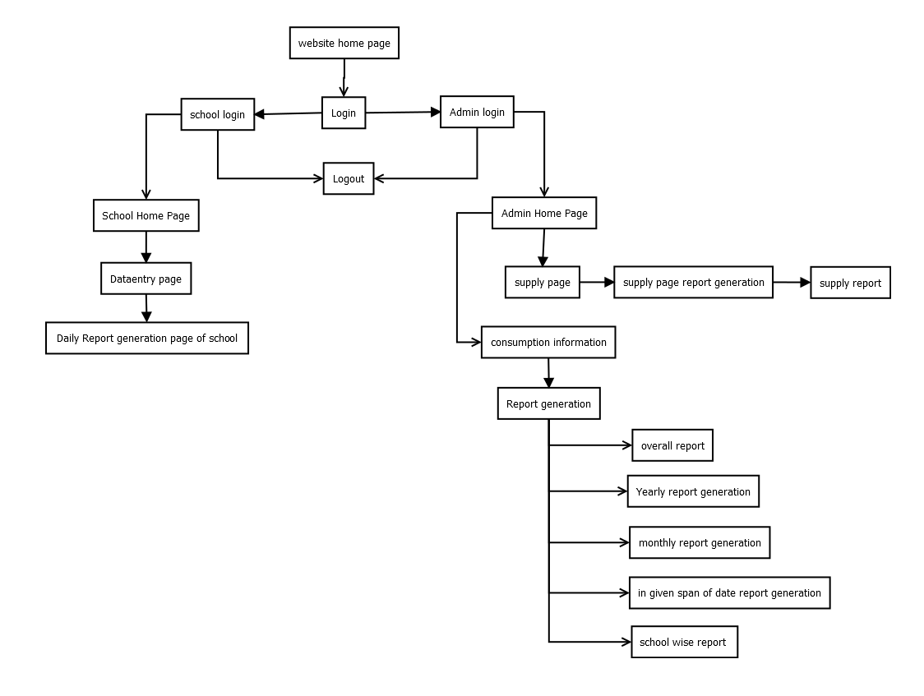
SITE MAP

Slide 7
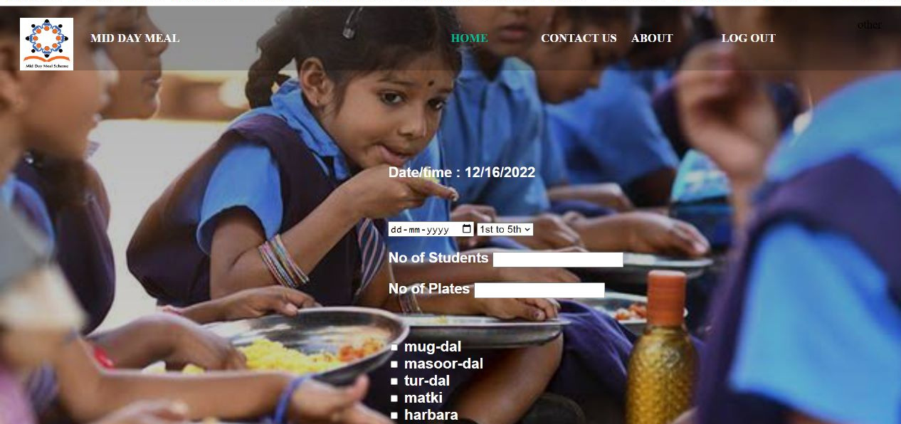
Dataentry
01
enter date
enter no of students and plates
02
03
select ingredients

Slide 8
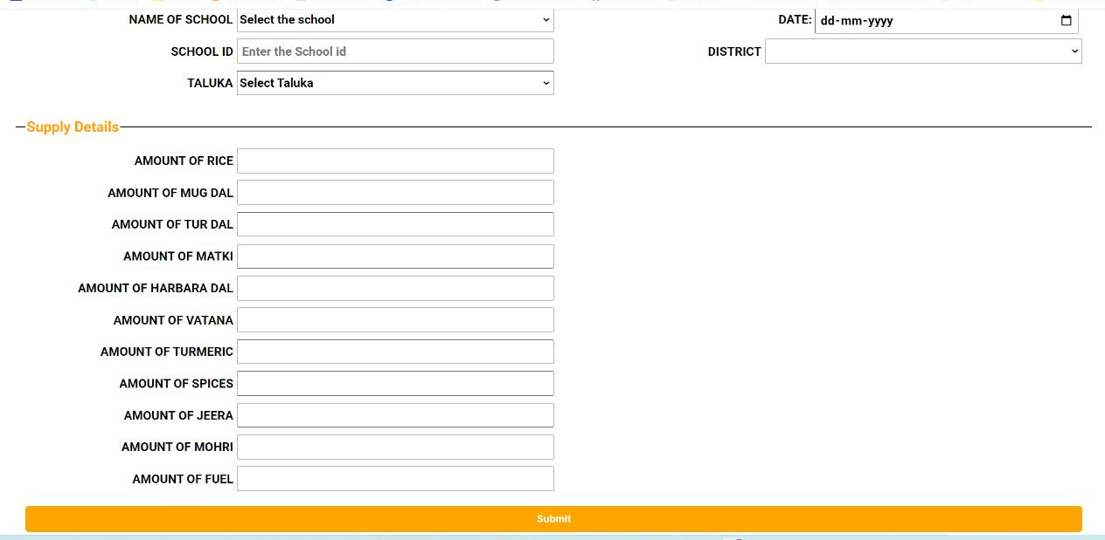
01
Select School Name
Supply page
Enter Supply Detailes
02

Slide 9
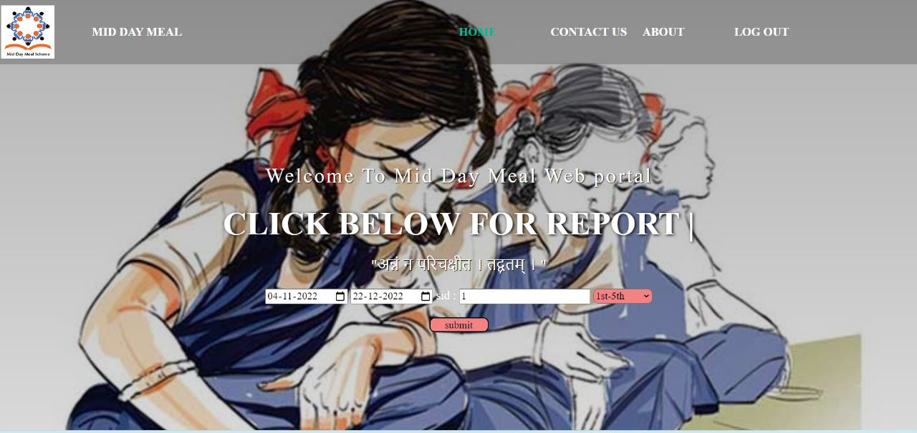
consumption page
01
select date span
Enter school Id
02

Slide 10
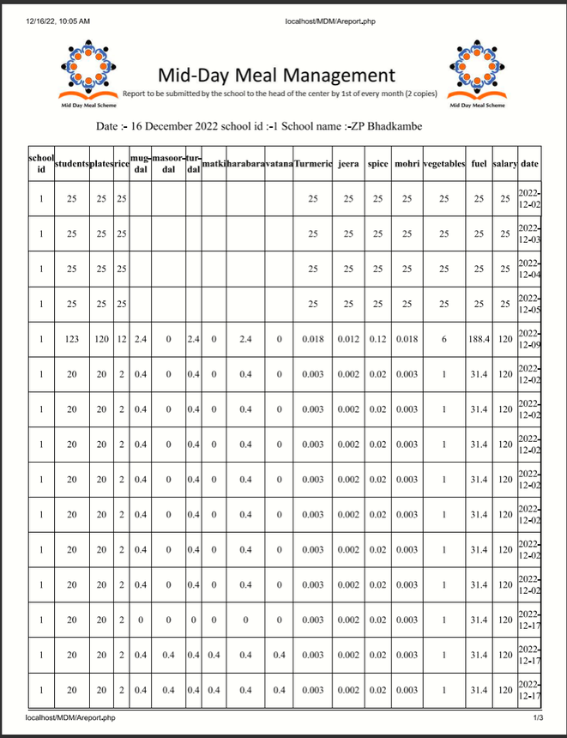
Report Generation
School Daily Report
Consumption Report
School overall Report
Date span Report
Supply Report

Slide 11
Thank
you!

